Slide 1

Spinnaker analytics
2024-03-09

Slide 2
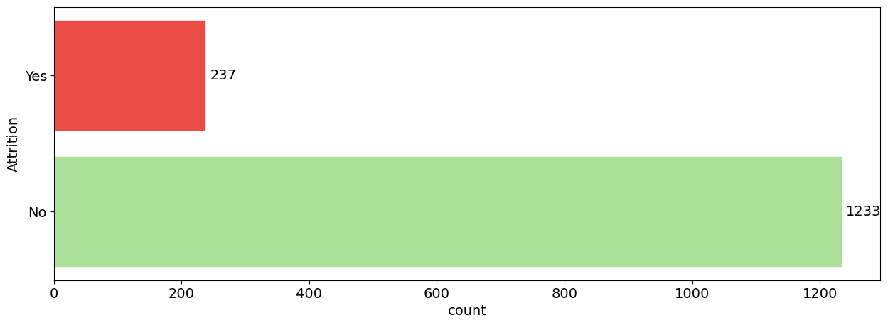
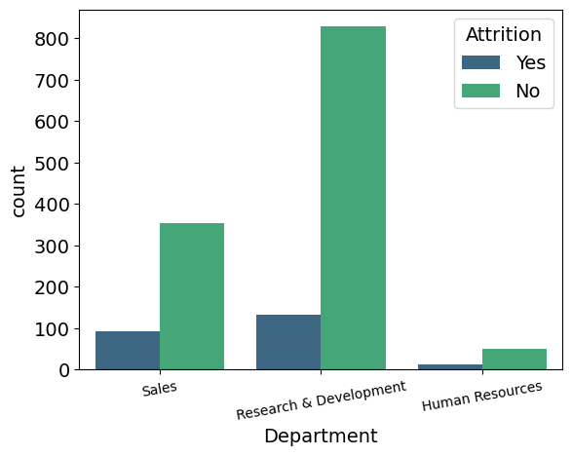
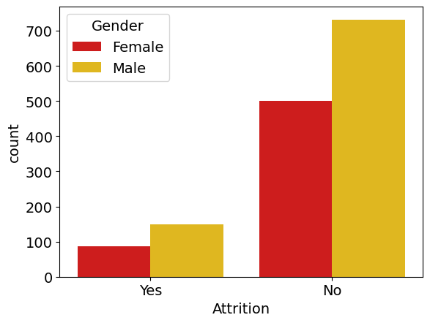
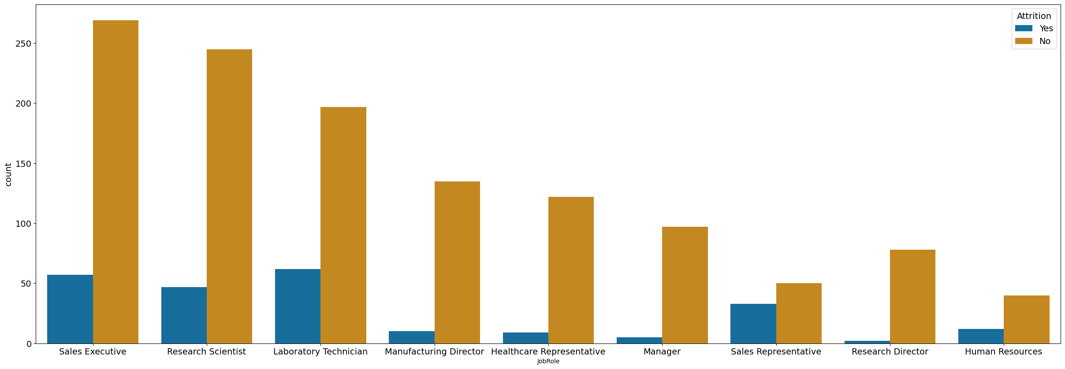
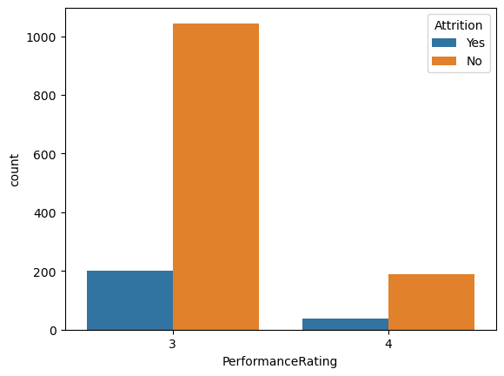
KEY METRICS
Total 1470 Number of Employees
237 have left the company
1233 currently working
Amongst 3 departments Research and Development department have more number of Attrition.
on an average most of employees are moderately performed because of performance rating lines in 3-4.
However employees having less performance rating are more likely to quit or we can say that company wants to fire those employees.
In specific we can see that the department of Research and Development likely to have more attrition rate in the job role of Laboratory technicians.
Male employees are more as compared to Females Hence ,Gender Category attrition rate is High in Male category.

Slide 3
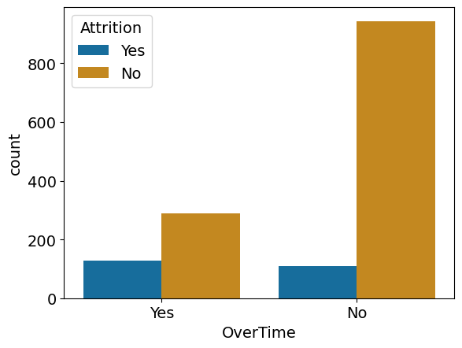
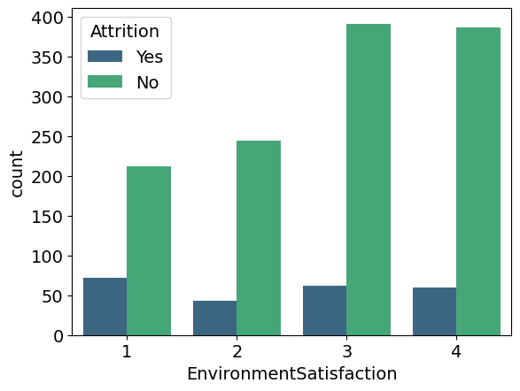
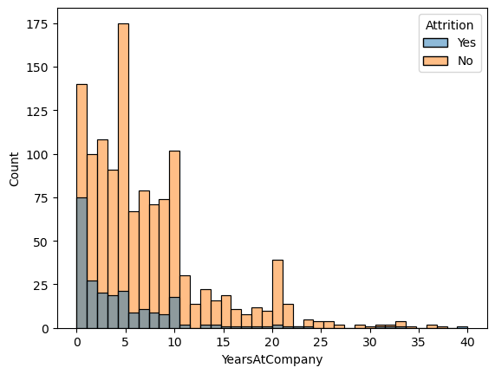
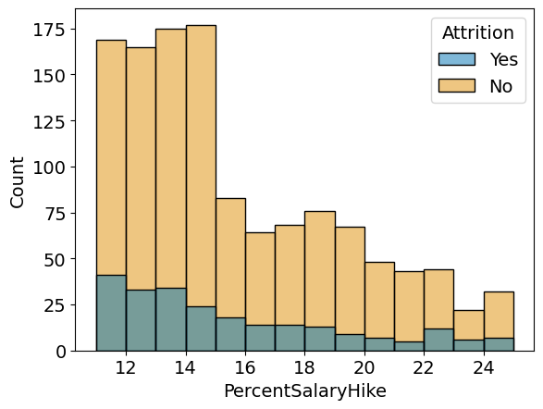
KEY METRICS
There are some employees which are leaving the company because over load of work.
We can assure them the extra pay or can hire the other employees to manage the workload if this fits in the annual budget.
Increase in rate of Environment as well as Job Satisfaction gives rise to increase in Attrition
" No“ (not willing to quit).
Here we can see that most employees likely to leave the company after 5 years, so they can take advantage of Gratuity.
Also need to introduce some policies for freshers so they can contribute more for the company.
Higher the salary percentage Hike , Lesser the Attrition Rate .

Slide 4
PREDICTIVE MODELING RESULTS
Accuracy
91%
Recall Rate
93%
Precision
89%
Techniques are used to predict the accurate results of the models and to increase the performance tunning.
We have used two techniques-: Decision Tree and Random Forest .
Random Forest achieved the higher rate of Accuracy , Recall Rate and precision Score wich enhances the model Performance.
Feature Selection is the most important factor while predicting the model.
Improvement Factors: Work Environment satisfaction, high attrition rate amongst freshers, Increase in salary hike,
Employees with low performance score, Queries of laboratory technicians.
Conclusion-: Job satisfaction motivates the employees to help the organization to reach towards its end goal. Job satisfaction and employee performance should not be compromised at any cost. Cultural events and sports activities can help to enhance the productivity of employees. Freshers can be more reliable , if provided with challenges and well aimed guidance.

Slide 5
Thank You.
2024-03-09

